Slide 1
computer engineering
Department

Slide 2
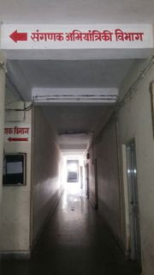
Department of computer engineering

Slide 3
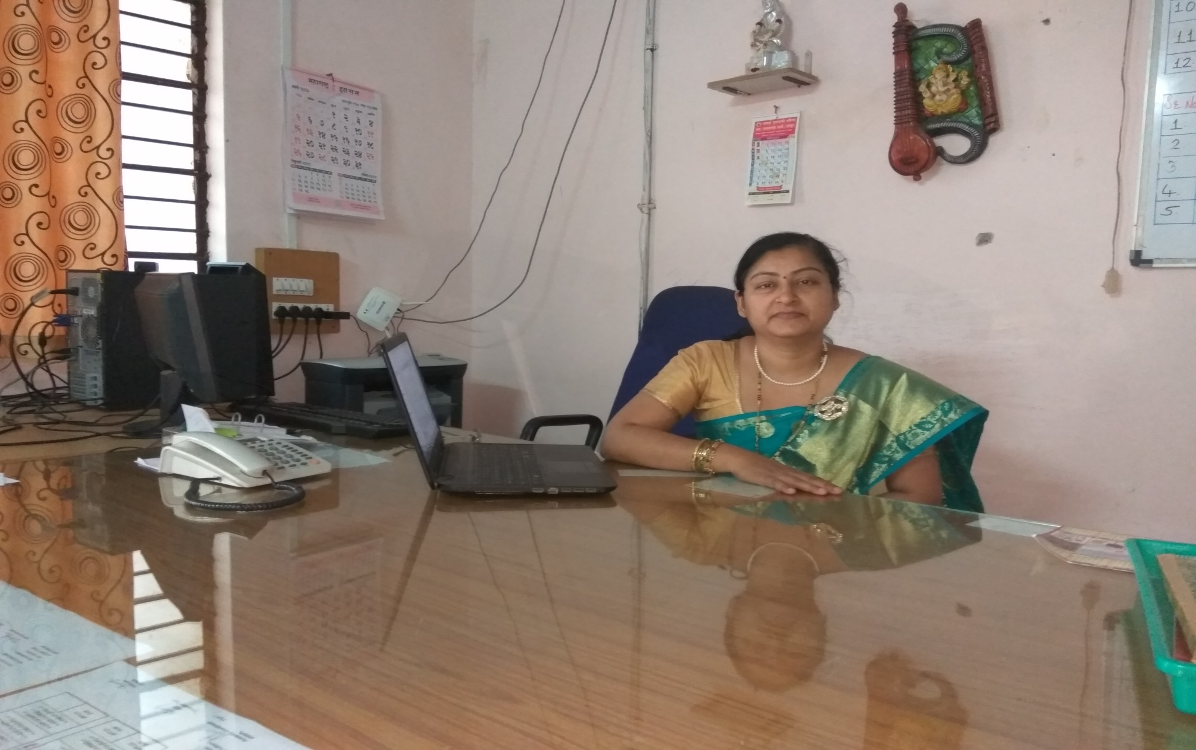
Hod mrs. J. r. hange

Slide 4
Admission status
I - YEAR |  |  | II – Year |  |  |  |  | III - Year
Enrolled | Re-Admitted | Total | Enrolled | Direct | Re-Admitted | Change Branch | Total | Enrolled | Re-Admitted | Total
63 | 0 | 63 | 55 | 17 | 02 | 03 | 77 | 65 | 1 | 66

Slide 5
Examination Summer 2017
Sr.no | Year & Course code | First class with Distinction | First Class | Second class | ATKT | Fail | Total
1 | CO2G | 15 | 10 | 12 | 10 | 14 | 61
2 | CO4G | 27 | 24 | 16 | 04 | 03 | 74
3 | CO6G | 49 | 06 | 02 | Nill | 06 | 63
Examination Winter 2017
Sr.no | Year & Course code | First class with Distinction | First Class | Second class | ATKT | Fail | Total
1 | CO1-I | 32 | 23 | 0 | 5 | 2 | 62
2 | CO3G | 21 | 24 | 07 | 8 | 11 | 71
3 | CO5G | 20 | 27 | 00 | 16 | 4 | 67

Slide 6
Strength of department
Regular HOD and Regular faculty staff fulfilled as per AICTE norms.
All faculties are holding Post Graduation higher degree like M-tech / ME related to discipline.
Department has five well equipped labs as per AICTE norms.
Very good academic result of winter 2017 of all classes i.e. 94% -98% is an average.
Total Five Student from CO3G got out of marks in AMT .
Got General championship in IEDSSA 2017-18 at Gramin Poly.Nanded. credit goes to Computer department’s participant of Kho-Kho, Kabbadi, Running sports winners.
Total four expert lectures and three MOU’s completed by computer department within academic year 2016-19..
Total Three Industrial Visits arranged in academic year 2017-18.
Most of the faculty deputed for Training / Workshops/ Curriculum development programed.
College Web-site designed and developed under the coordination of computer department.
Prerequisite knowledge based classes arranged for direct second year students.

Slide 7
Weakness of department
Posts of Technical Lab assistants are not fulfilled as per AICTE norms.
Minimum three regular teaching staff required as per Students Strength.

Slide 8
Faculty Strength
Sr. No | Particulars | Required as per AICTE / PCI and MSBTE Norms | Filled posts
1 | HOD | 1 | 1
2 | Lecturers (Regular) | 7 | 4
 | Lecturers (contract) |  | 0
 | Lecturers (visiting) |  | 6

Slide 9
Faculty
Sr. No | Name | Qualification | Experience in Yrs.
1 | Mrs. Hange J R | ME- CSE | 23
2 | Mr. Chavan S V | ME- CSE | 27
3 | Ms. R. D. Kasar | M-Tech CSE | 14
4 | Ms. M. G. Mulge | M-Tech CSE | 12
5 | Mrs. Patil A S | ME- CSE | 06
6 | Ms. Shastri A. J | ME- CSE | 04
7 | Mr.. Salunke R. B | BE-CSE | 03
8 | Mrs.Bharati R R | BE-CSE | 03
9 | Ms.Pathan S A W | BE-CSE | 01
10 | Ms.Late R B | ME-CSE | 06
11 | Ms.Mundada A M | BE-CSE | 02

Slide 10
Lab assistant
Sr. No | Name | Qualification | Experience in Years.
1 | Ms. N. D. Hishobe | Diploma in IT | 23

Slide 11
Laboratory
Sr. No | Name of Lab | No of Major Equipments | Cost
1 | INTERNET LAB | PC-IV 20, LCD PROJECTOR , UPS | 585456
2 | PROGRAMMING LAB | PC-IV 16, UPS , LCD PROJECTOR | 848047
3 | O.S. LAB | PC-IV 17, UPS | 1091670
4 | SOFTWARE DEVELOPMENT LAB | PC-IV 16 | 686997
5 | HARDWARE LAB | MICROPROCESSOR KITS, PRINTERS | 314317

Slide 12
Result Analysis – W- 2017
Class | Total | Clear | Failed | ATKT | % Passing
CO1-I | 62 | 55 | 2 | 5 | 84.14%
CO3G | 71 | 45 | 13 | 8 | 70.42 %
CO5G | 67 | 47 | 4 | 16 | 70.14 %

Slide 13
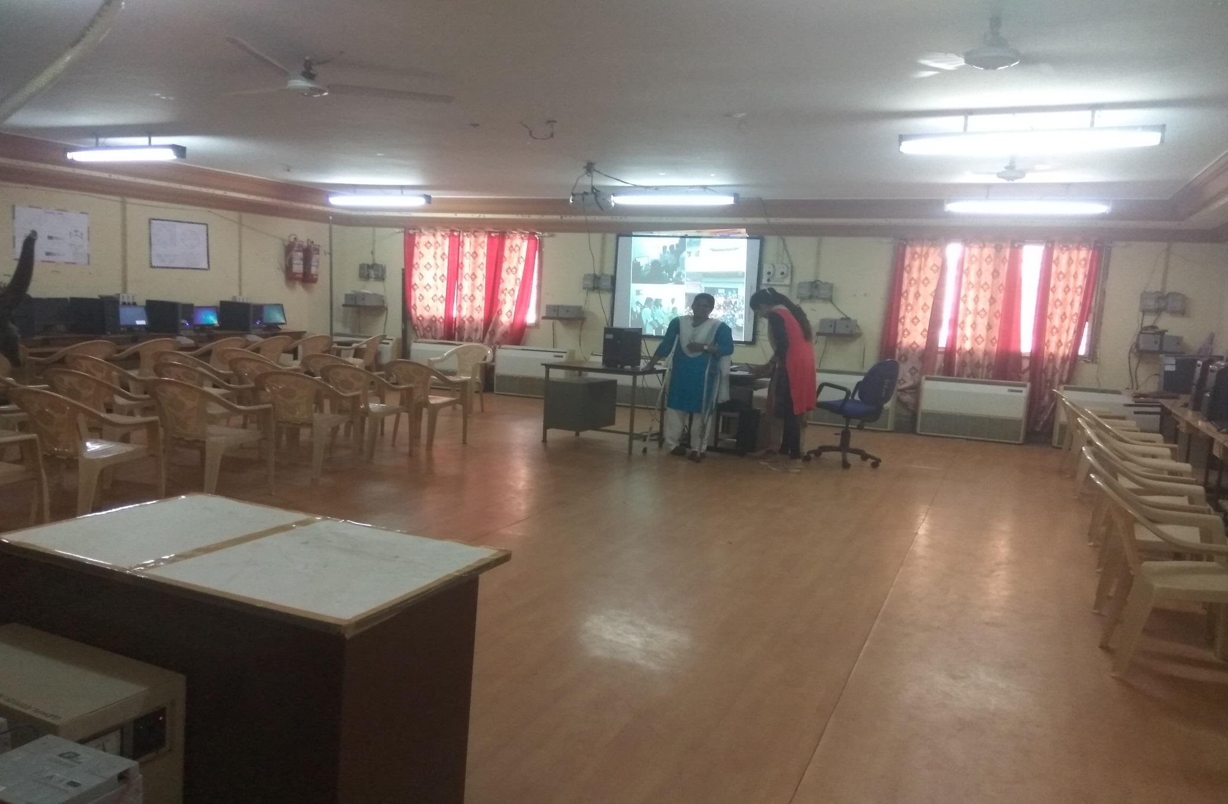
Internet Lab -1

Slide 14
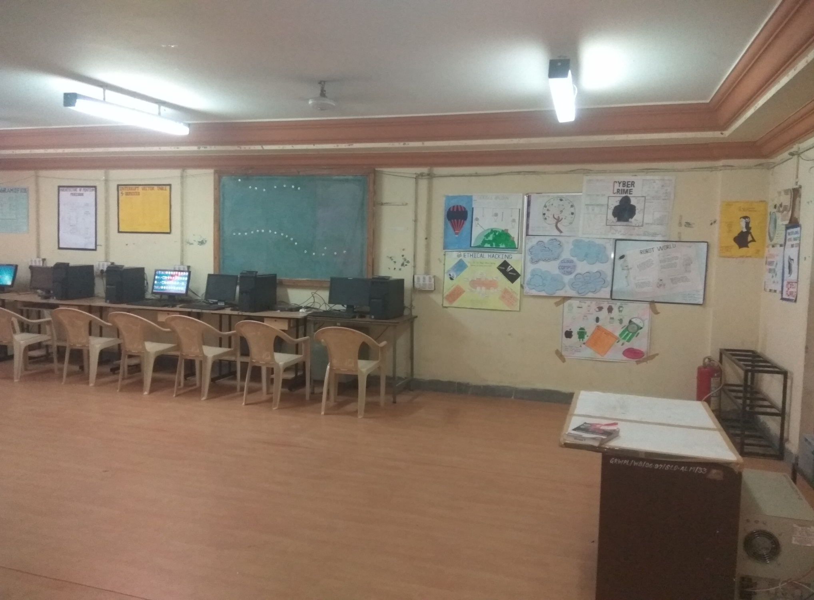

Slide 15
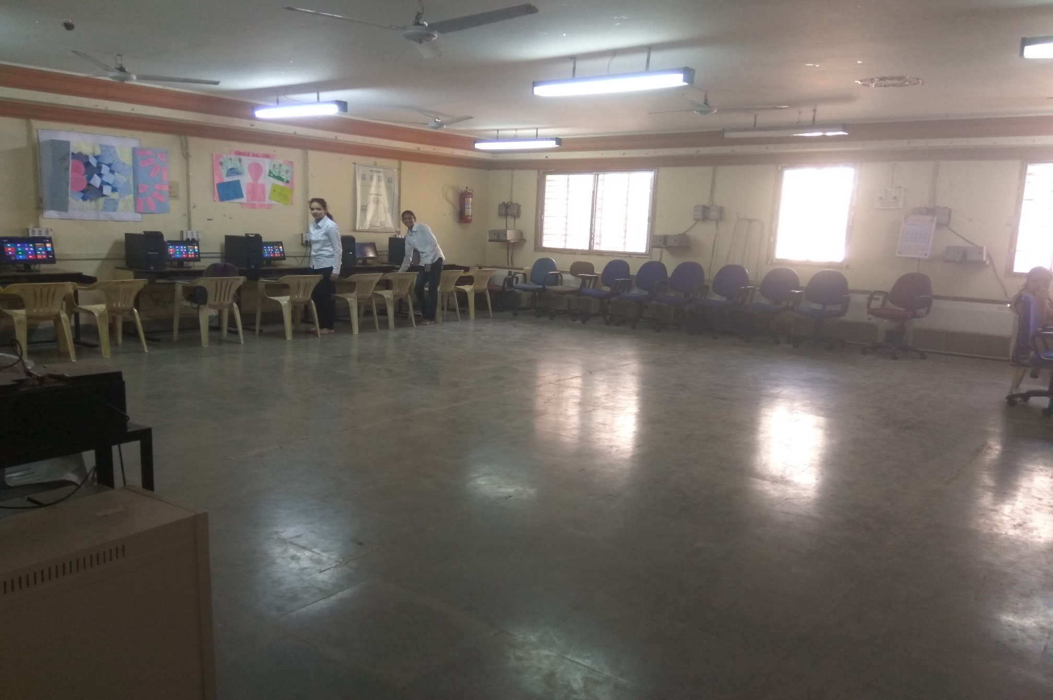
programming Lab -2

Slide 16
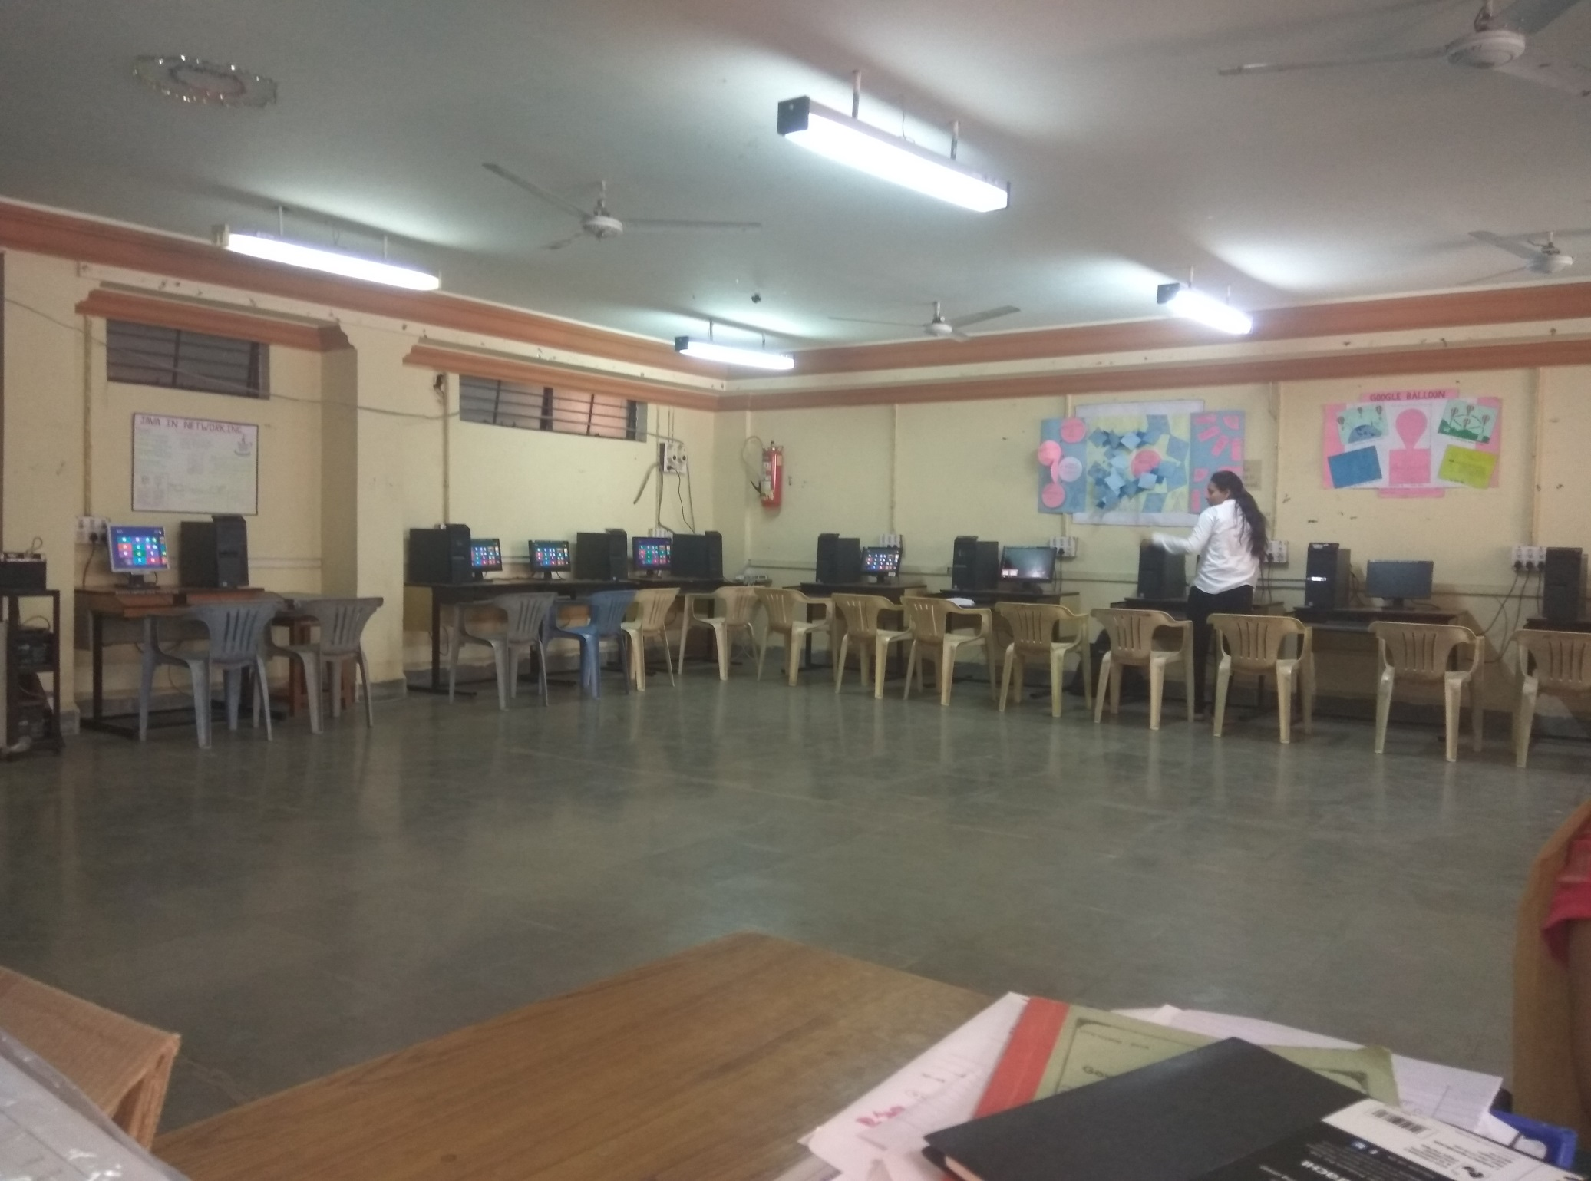

Slide 17
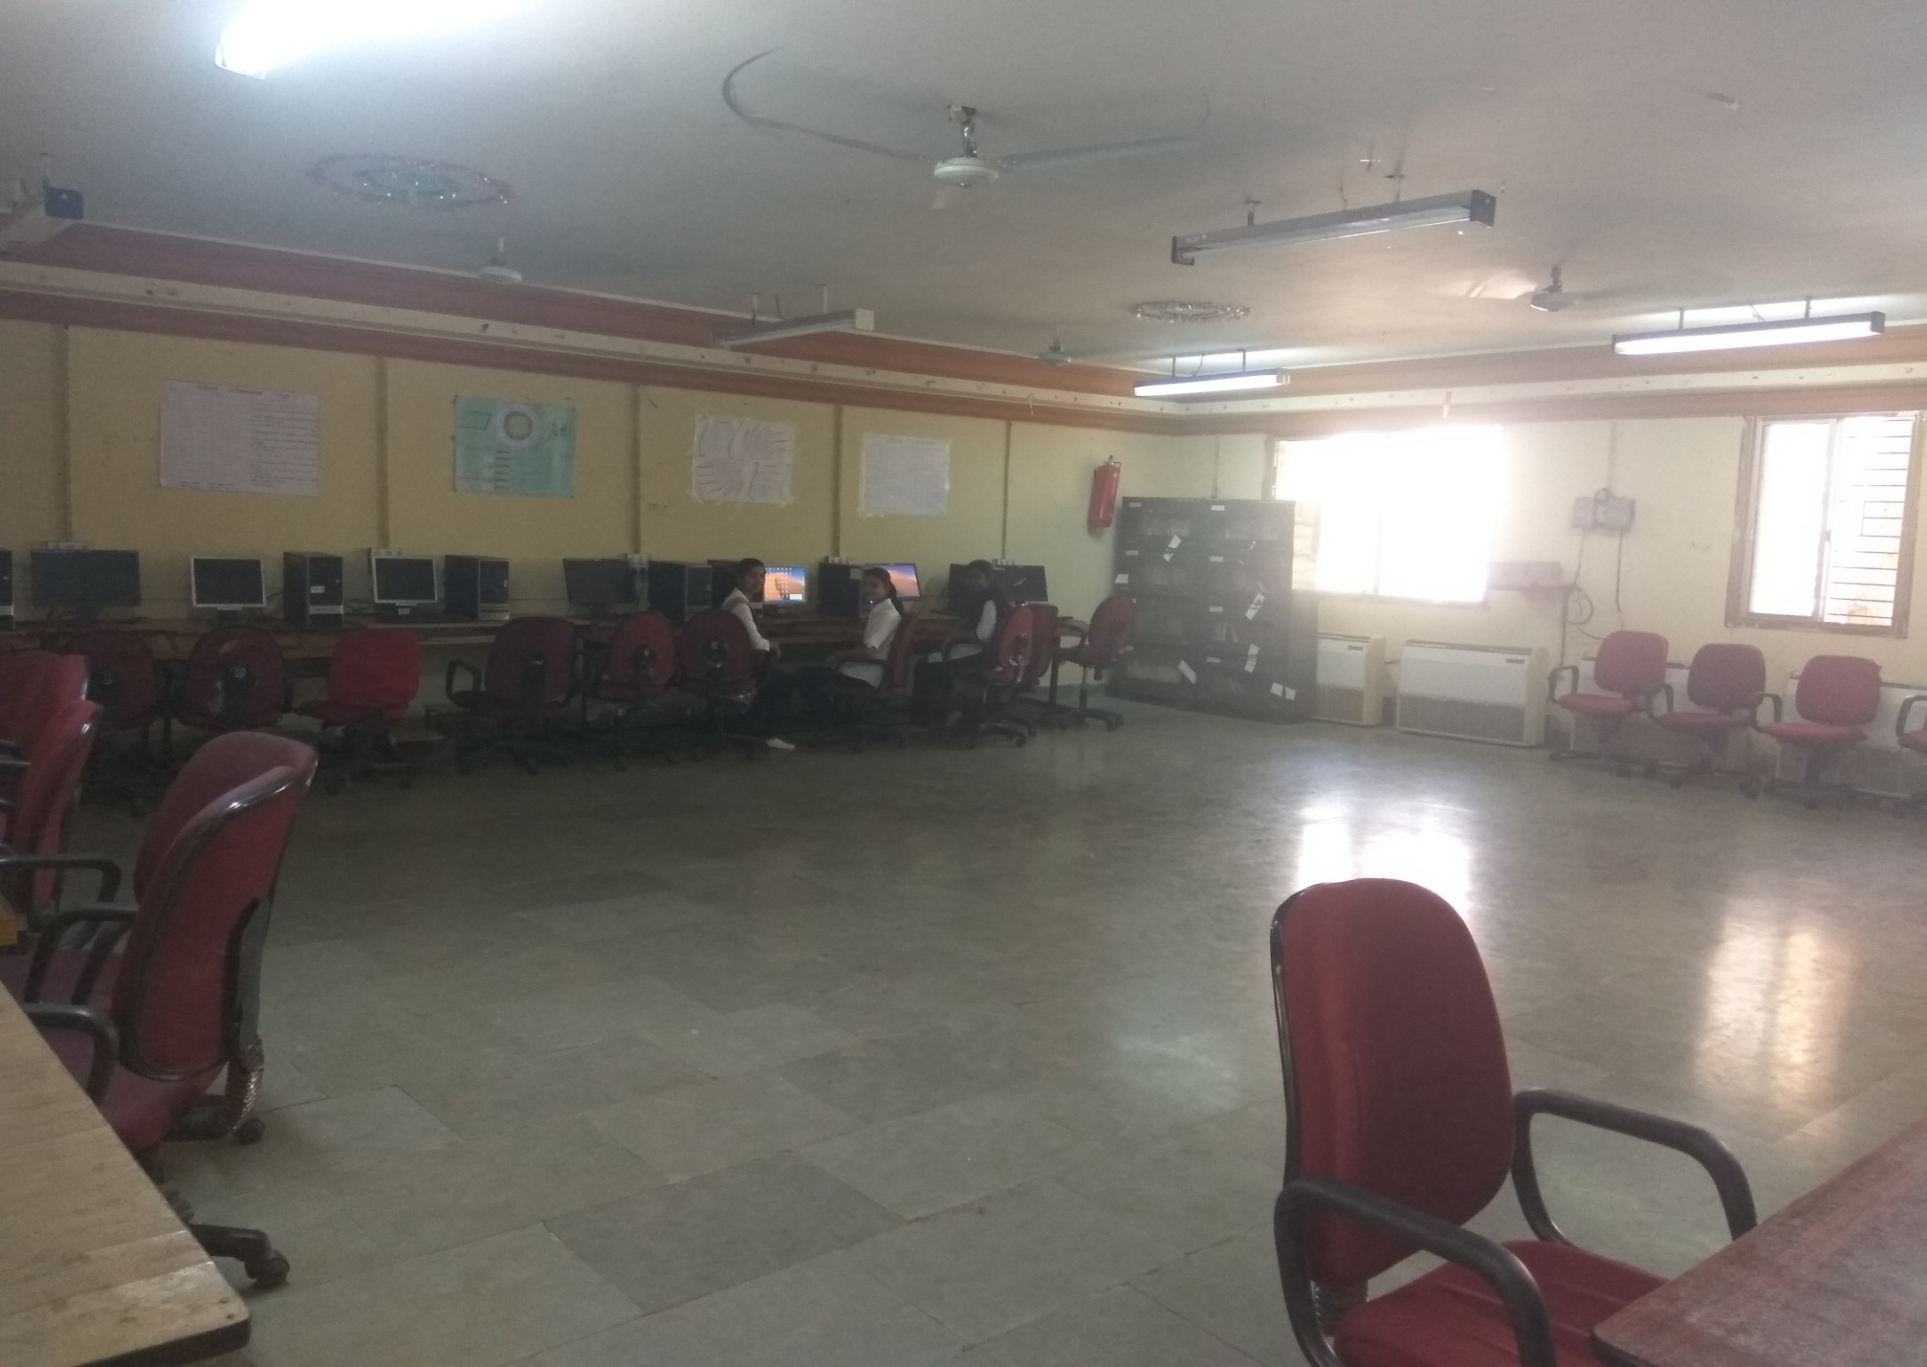
Operating system lab -3

Slide 18
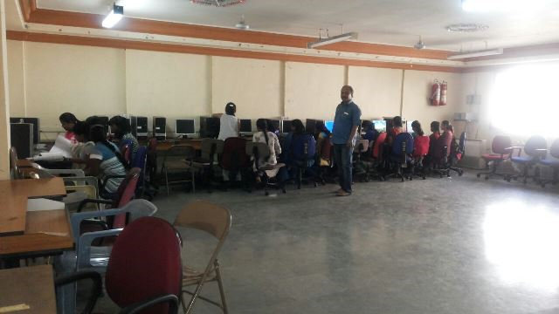

Slide 19
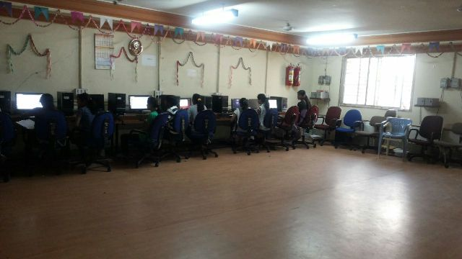
Software development lab -4

Slide 20
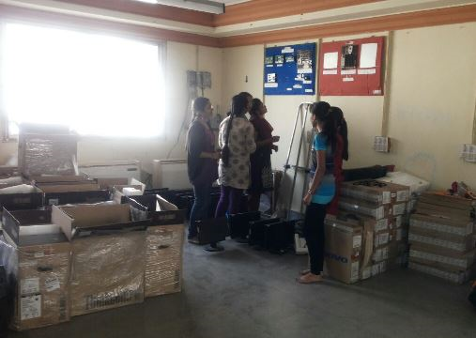
Hardware lab-5

Slide 21
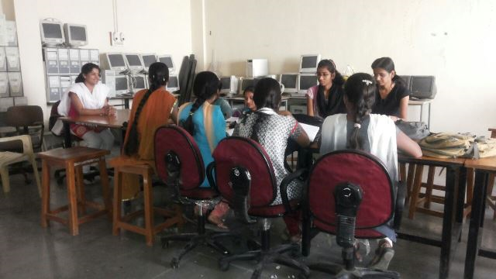
COMPUTER H/W LAB-5

Slide 22
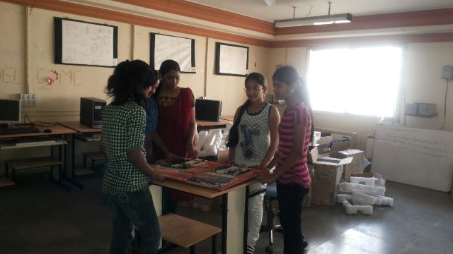
h/w lab - : motherboard observation

Slide 23
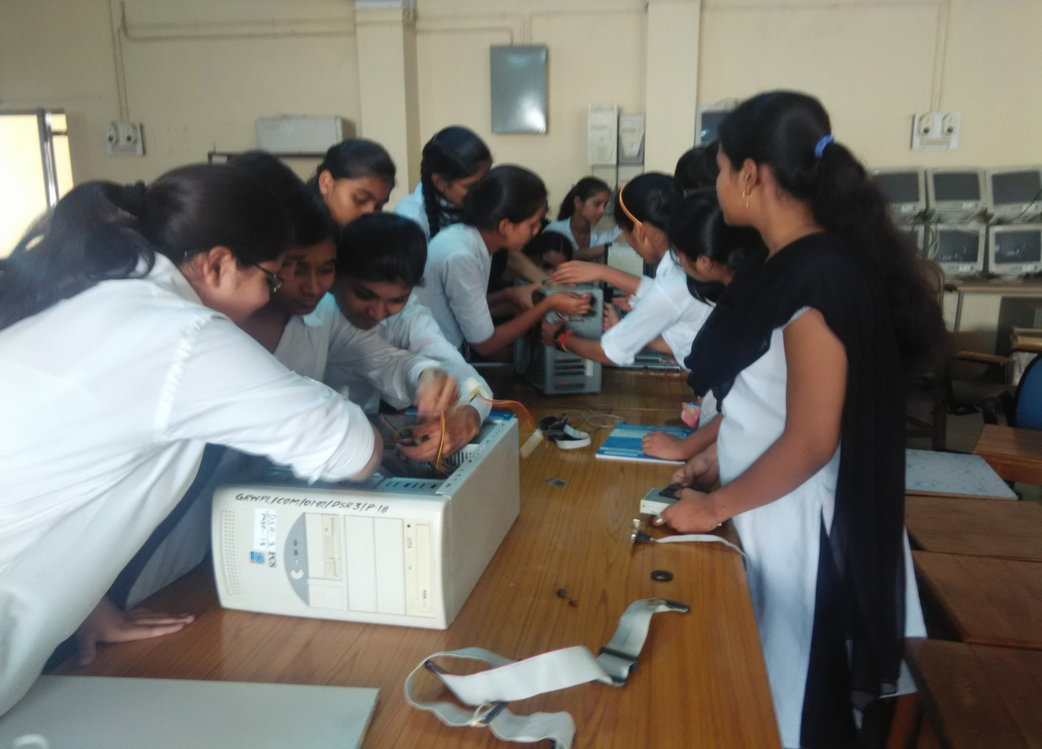
COMPUTER H/W LAB

Slide 24
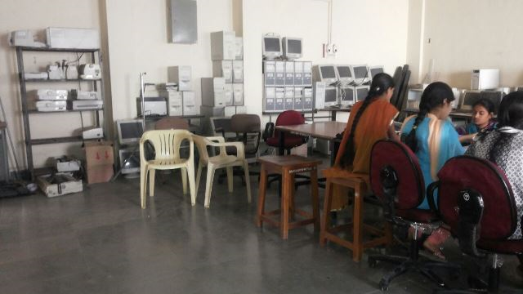

Slide 25
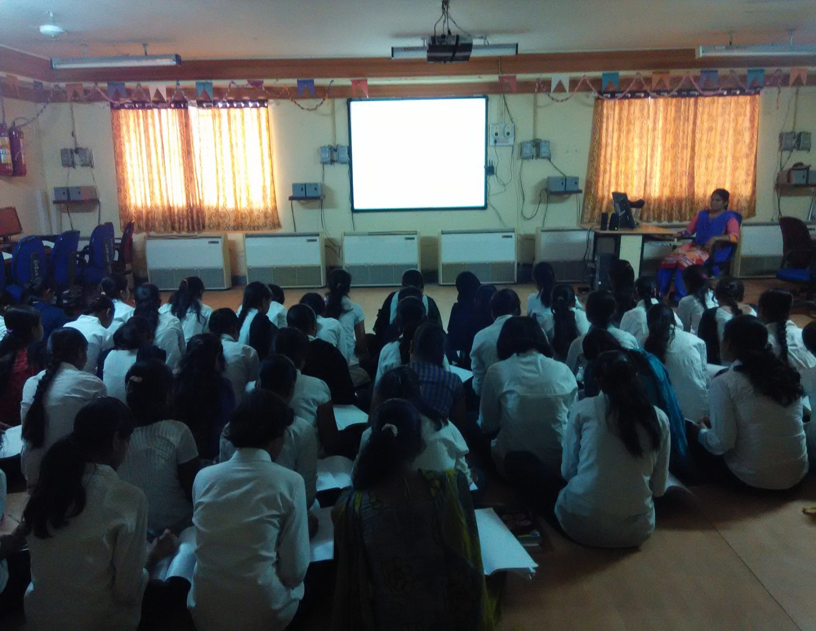
Digital classroom

Slide 26
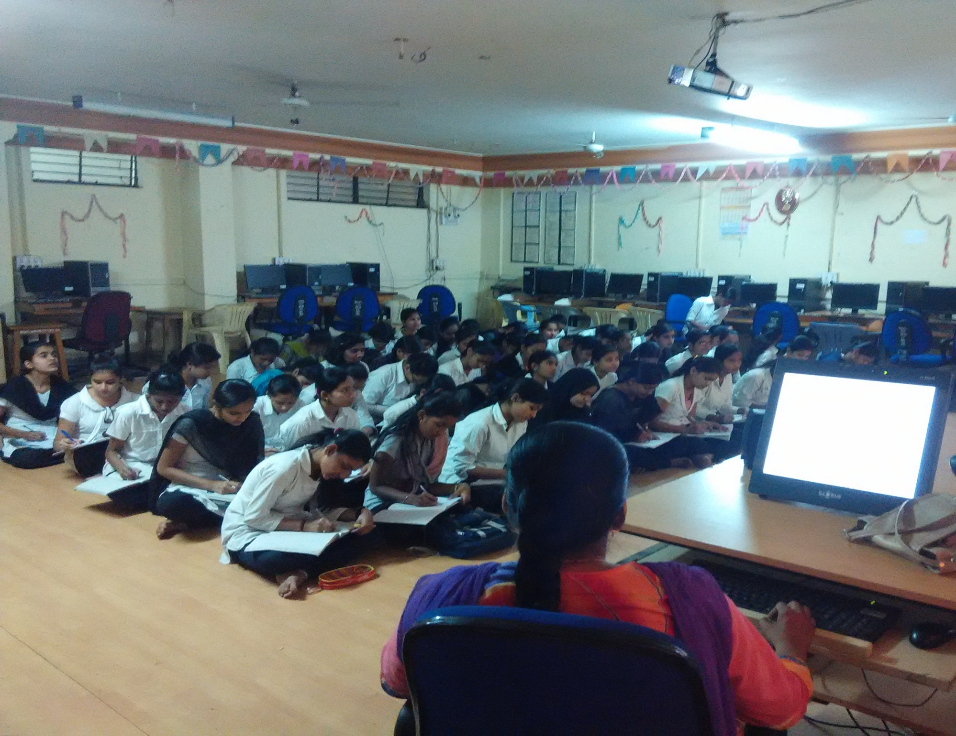

Slide 27
INDUSTRIAL VISITS
Sr. No | Name of Industry | Address Contact Details | Semester | Subject Name | Name of Staff to be involved
1 | BSNL - Bharat Sanchar Nigam Limited Latur | BSNL office, Gandhi Chowk Latur- 413512 | CO5G | PPO | Mr. R D Kasar, Mr. R B Salunke , Ms. A J Shashtri
2 | Mindlabz Software Solutions ,Latur | Brarshi Road,Latur | CO5G | IPR | Mrs. A. S Patil, Ms S.A.Pathan
3 | Mindlabz Software Solutions ,Latur | Brarshi Road,Latur | CO3G | PPT | Mr. S V Chavan , Mrs. A S Patil

Slide 28
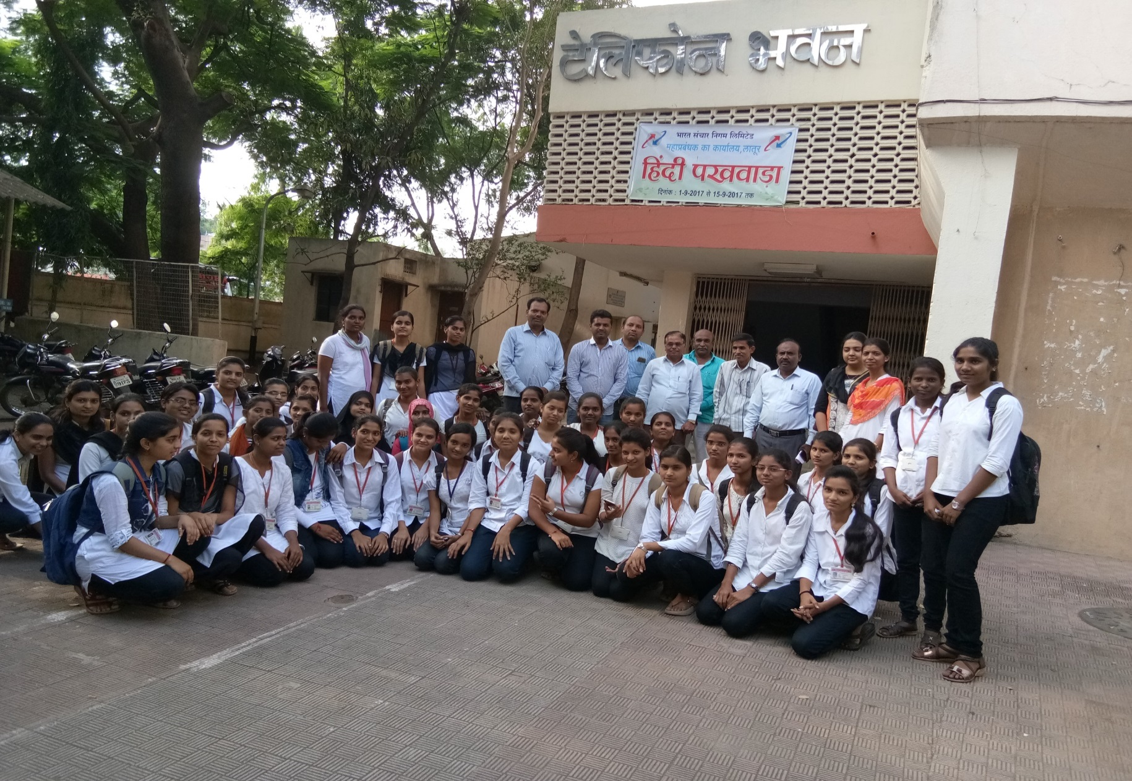
Industrial visit-bsnl

Slide 29
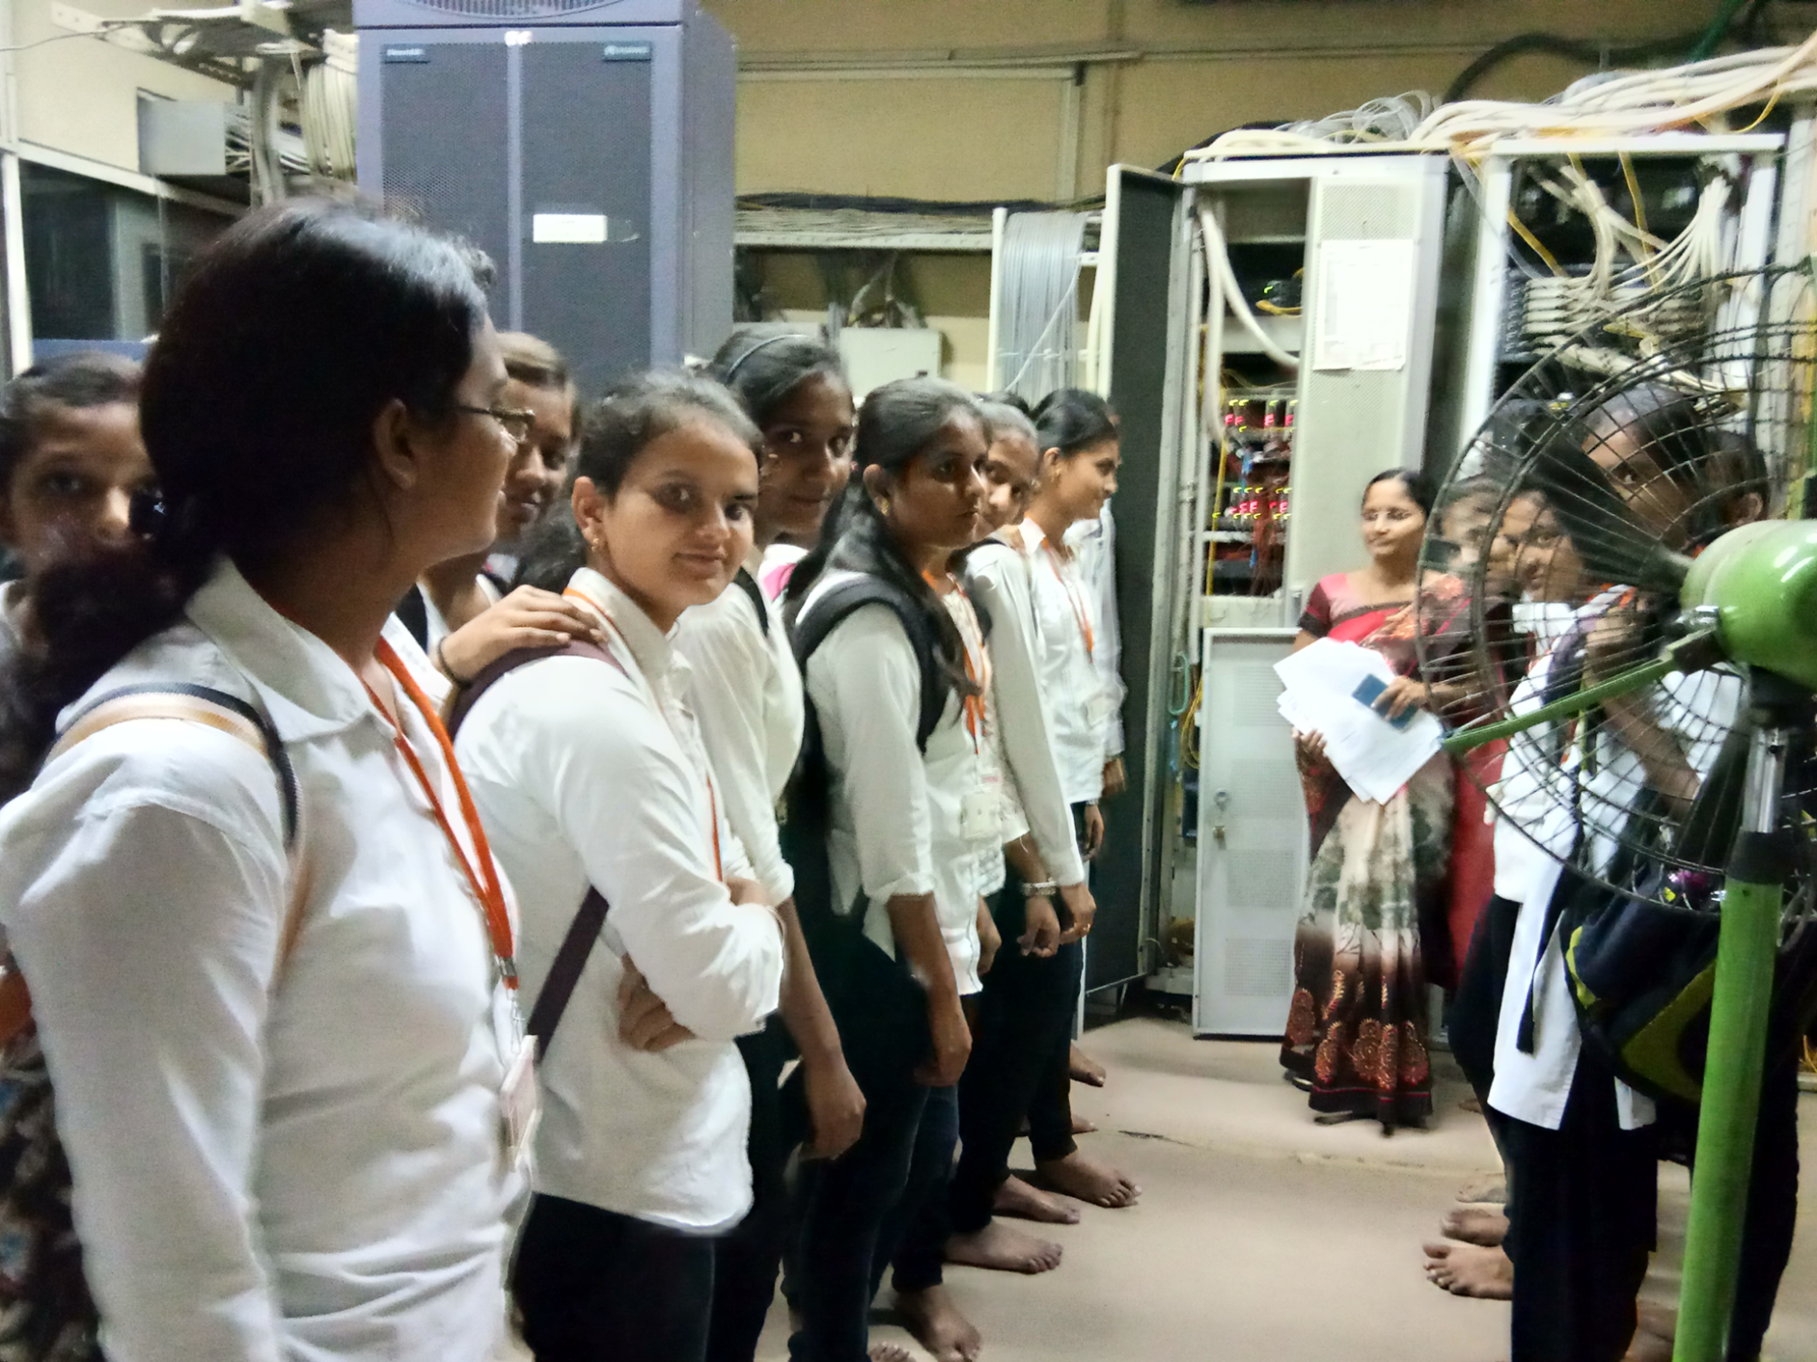

Slide 30
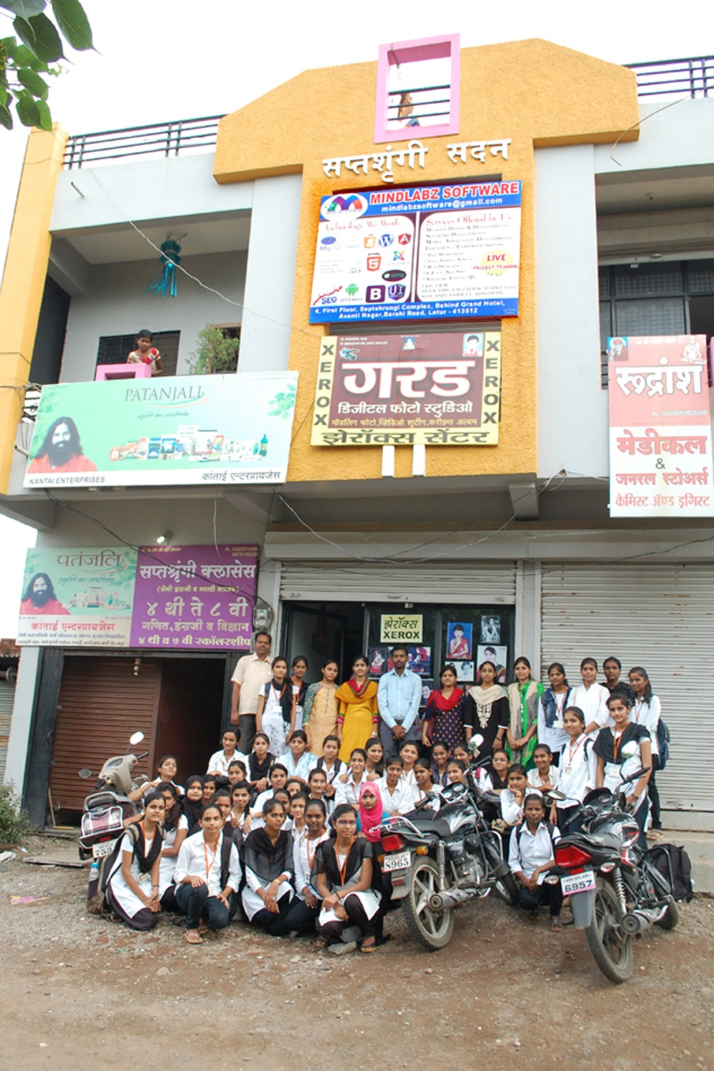
Industrial visit :-
Mindlabsz software development pvt.ltd latur

Slide 31
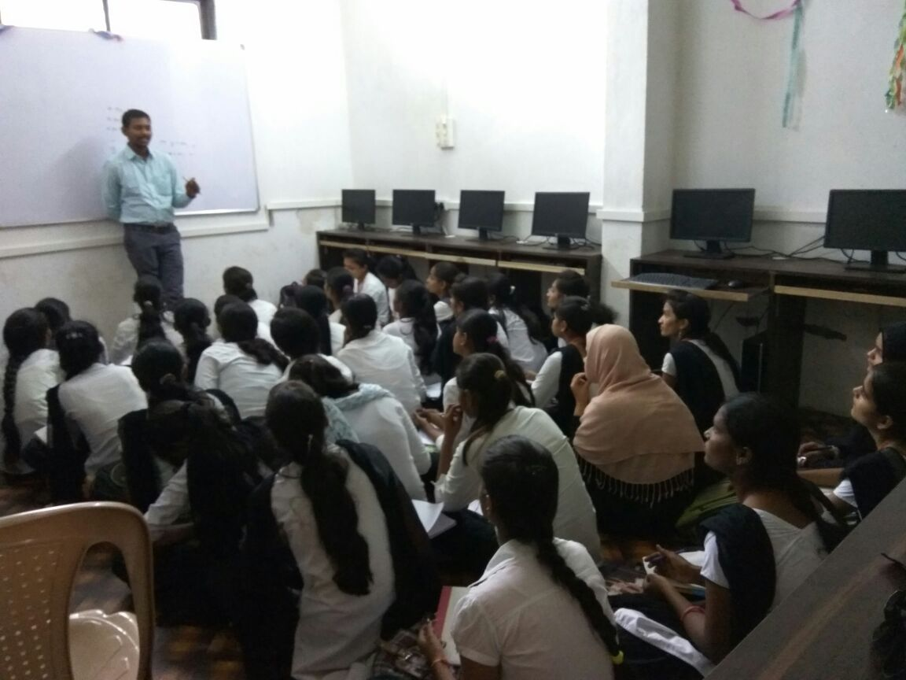

Slide 32
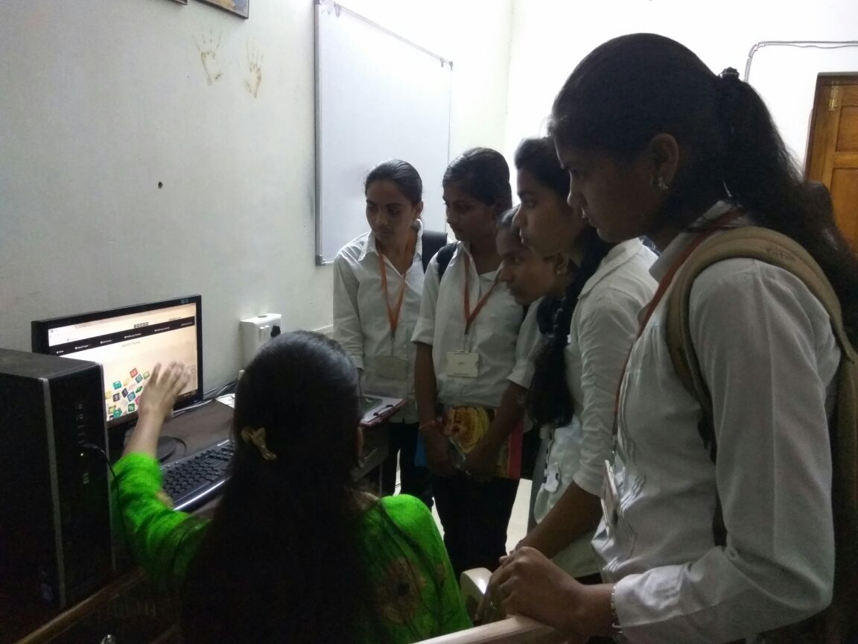

Slide 33
Expert lectures: list
Sr. No | Name of Expert Contact Details | Topic | Subject | Semester | Name of Inviting Faculty
1 | Mrs. Swami Varsha VA³ IT Services Pvt. Ltd. Latur- 413531 | Eithical Hacking | Computer Security | CO5G | Ms. M G Mulge, Ms. A S Patil
 |  | Cloud Computing | Database Management system | CO3G
2 | Sonali A Mustare Synechis Aquilam Solutions Pvt. Ltd. Pune | Awareness about IT Technologies | Operating system | CO5G | Ms. M G Mulge, Ms. A S Patil
 |  |  | Programming Laguages | CO3G
3 | Abhijeet A. More CYIN Solutions Pvt. Ltd. Pune | Internet Security | Software Testing and Security | CO6G | Ms. M G Mulge, Ms. R D Kasar
 |  |  |  | CO4G
4 | Mr. Ganesh STEP- Software Technologies Excellence Program, Hyderabad - 500032 | Thought Works | EDP | CO6G | Mr. S V Chavan, Mr. S V kendre

Slide 34
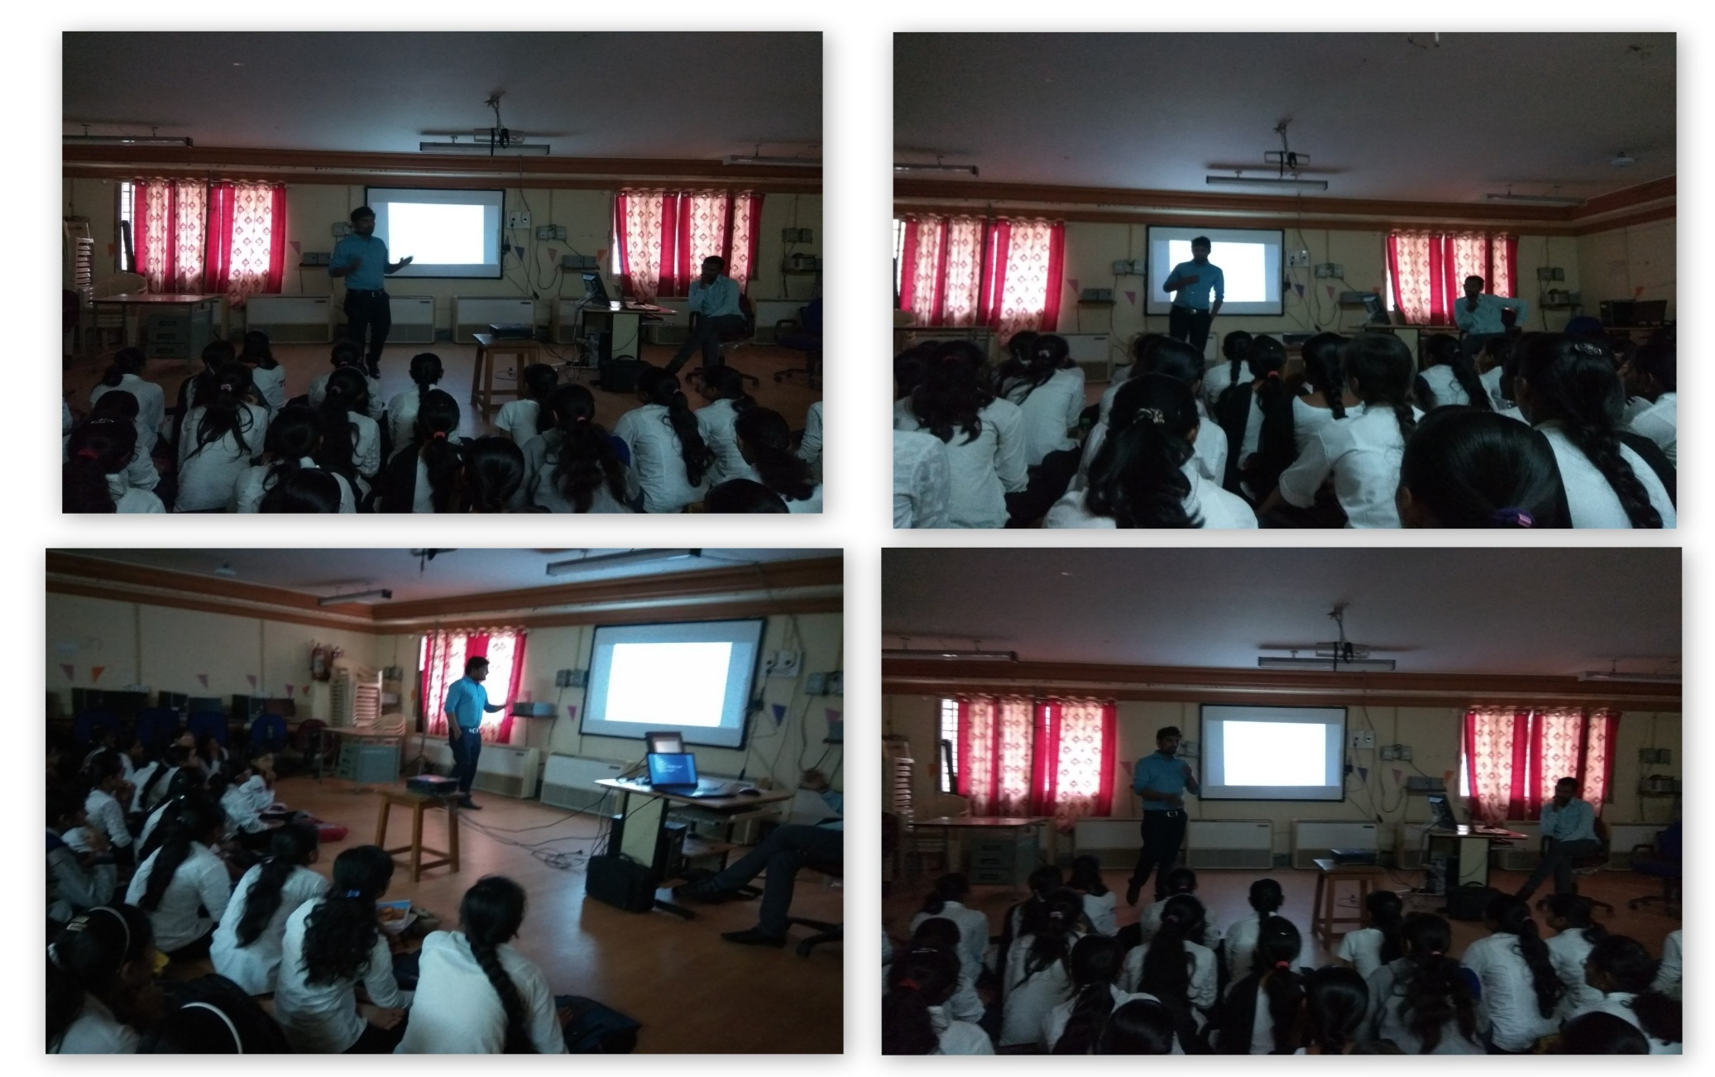
Expert lecture – mr. mangesh

Slide 35
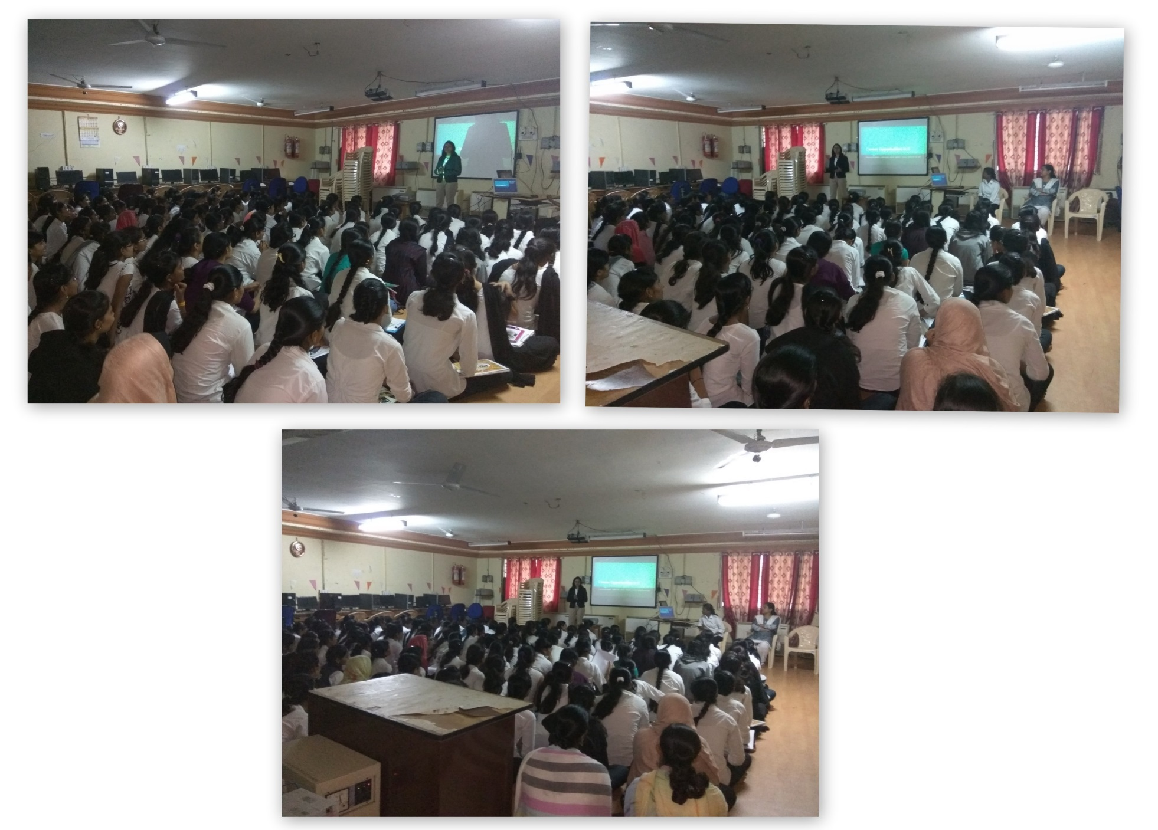
Expert lecture – varsha swami

Slide 36
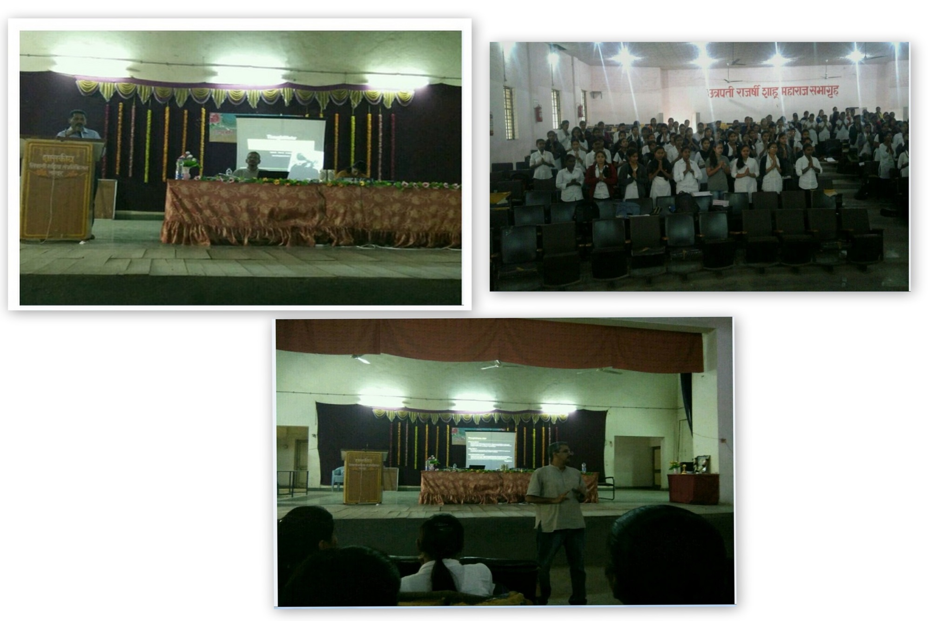
Expert lecture – mr. ganesh

Slide 37
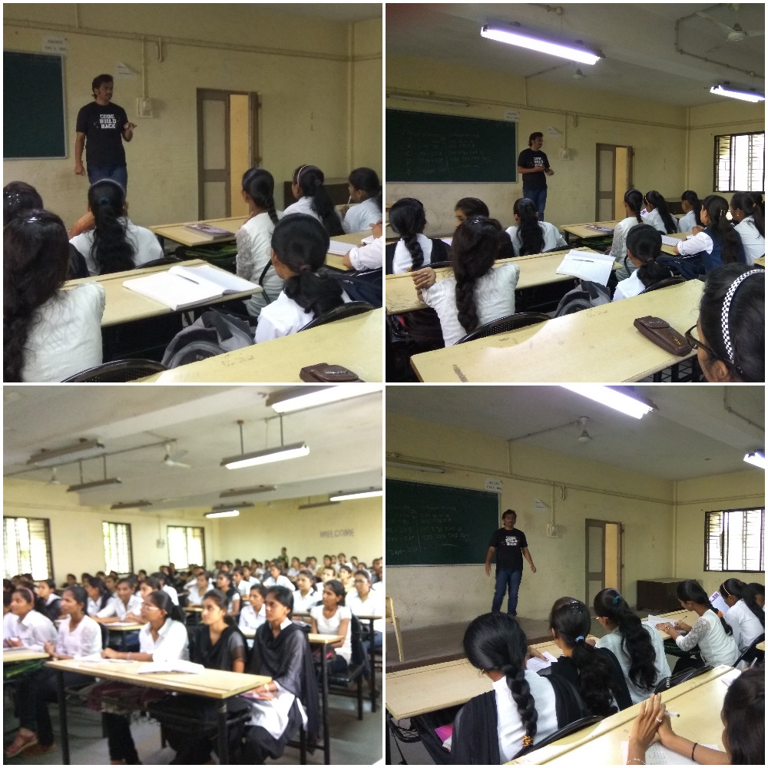
ONE DAY WORKSHOP ON INTERNET SECURITY BY A.A.MORE

Slide 38
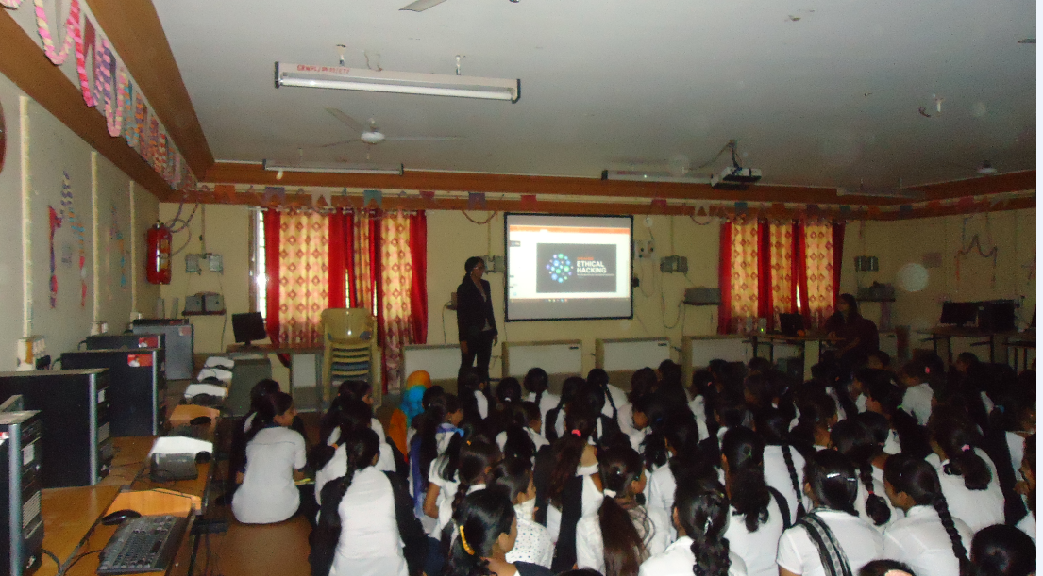
ONE DAY WORKSHOP BY
Varsha Swami , Director of Oriange Pvt. Ltd . Latur

Slide 39
STUDENT ACTIVITIES

Slide 40
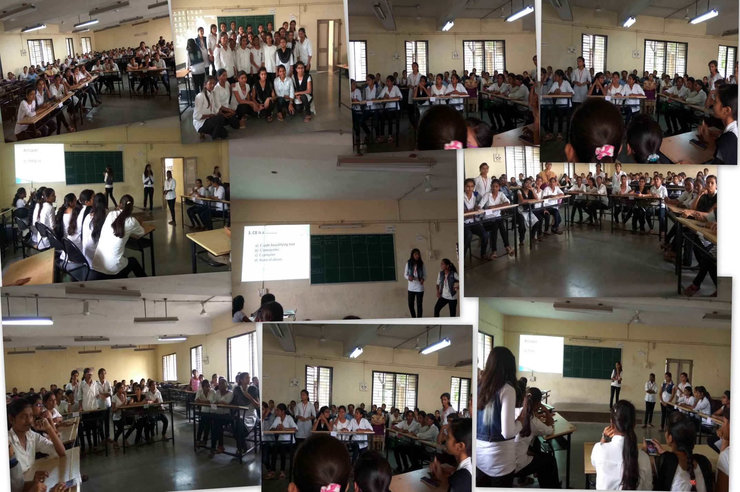
QUIZ Competition

Slide 41
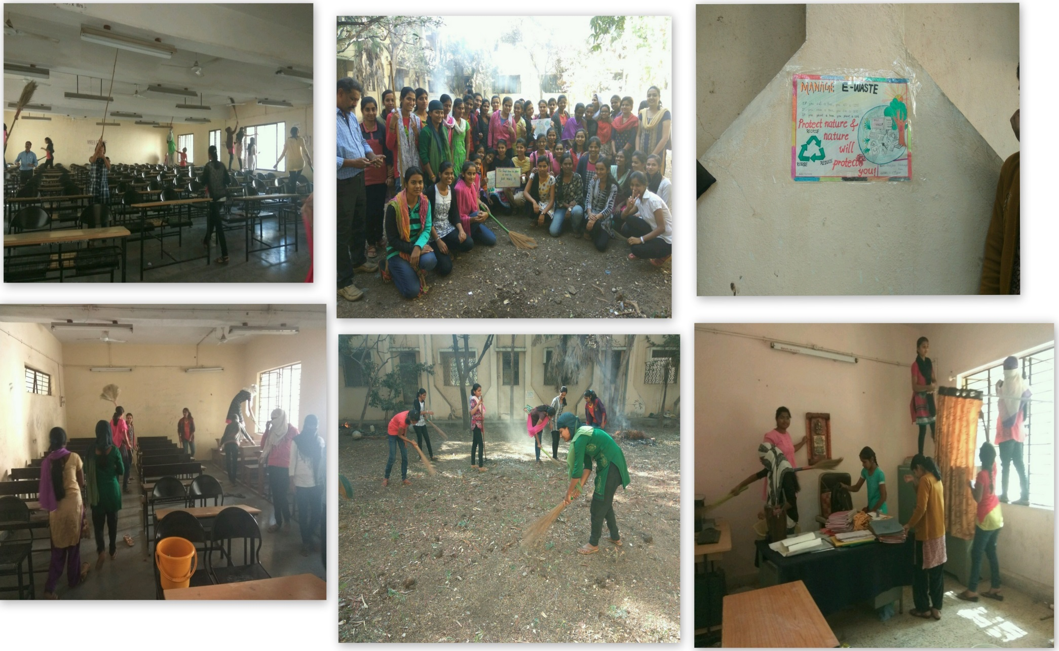
SWACHATA MOHIM(Dept. Cleaning Activity )

Slide 42
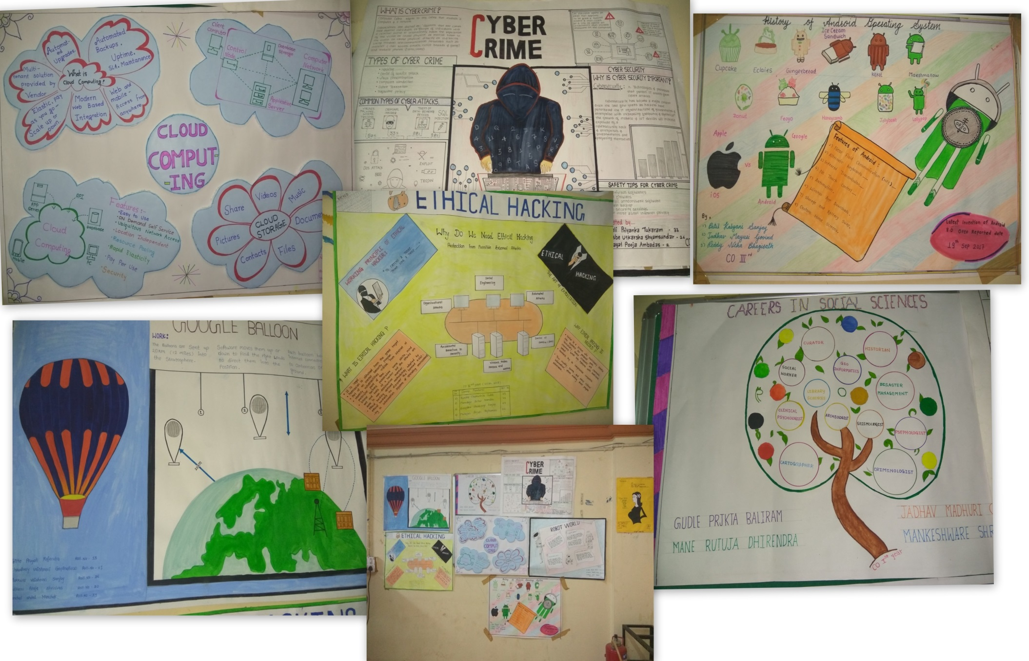
Poster Presentation

Slide 43
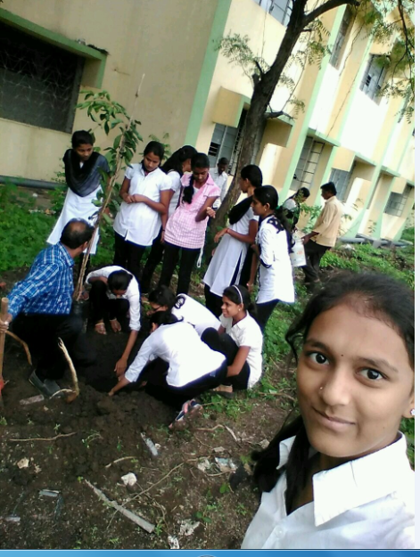
Tree Plantations

Slide 44
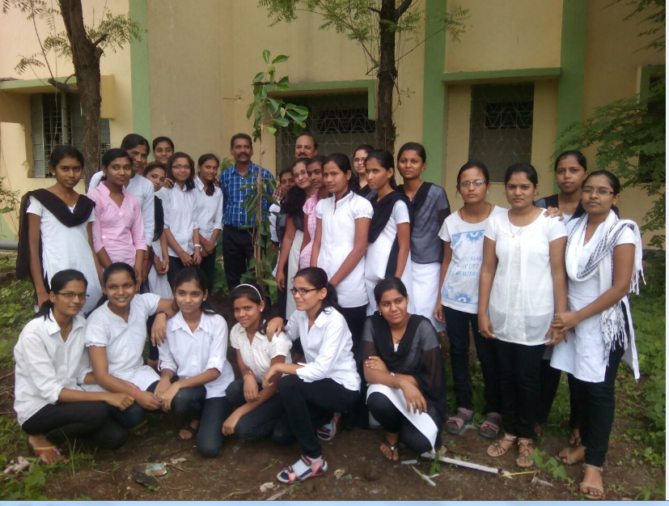

Slide 45
FACULTY TRAINING DEPUTATIONS
SR. No | Name of staff to be deputed for Training (Current sem) |  | Name of Staff Comeleted Training in Previous Academic
 | Content Updating | Any Other | Content Updating | Any Other
1 | Mrs.J R Hange HOD of Computer Department " Outcome Based Education (OBE0 Philosophy and NBA Awareness" Sponserd by DTE at G P Pune Duration 9/01/2017 to 13/01/2017 | Ms. R D Kasar, Lecture Computer Engineering Attended " BEST- Basic Employability skill Training " at NITTTR Bhopal Duration 23/01/2017 to 3/2/2017 | Mrs. Hange J R Lecturer , G P Pune "Curriculum Revision Workshop" at NITTTR , extenssion Center Pune Duration 12/01/16 to 14/01/16 | Mrs. J R Hange Lecturer, Govt. Pune " Personality Development" at G.P. Pune Duration 12/2/2016
2 |  |  | Mrs. J R Hange HOD of Computer Department, " Orientation Training on Learning Management System (LMS0 for e-Learning At YASHADA Pune Duration 29/12/2016 to 31/12/2016 | Ms. M G Mulge Lecturer Computer Department, " Workshop On Matlab Programming " at GRWP Latur Duration 31/12/15 to 4/01/2016
3 |  |  | Mrs. J R Hange HOD of Compuer Department GRWP Latur " First Course detailing Workshop for 1st group Third Semester Programme at NITTTR, Extension Center Pune Duration 8/11/2016 to 10/11/2016 | Ms. M G Mulge Lecturer, Computer Engineering Dept. Attended TEQIP-II on subject " Basic chemichal Technology in Nanotechnology" at Govt Engineering college Karad. Duration 23/05/2016 to 28/05/2016
4 |  |  | Mrs. J R Hange HOD of Compuer Department GRWP Latur " First Course detailing Workshop for 1st group Fourth Semester Programme at NITTTR, Extension Center Pune Duration 8/11/2016 to 10/11/2016 | Ms. M G Mulge, Lecturer in Computer Engineering Department Attended Phase -I Sponserd by NITTTR at CMASS Engineering College Aurangabad Duration 20/5/2016 to 10/06 2016

Slide 46
FACULTY TRAINING DEPUTATIONS
5 |  |  | Mrs. Patil A S Lecturer Computer Engi. Dept. attended Workshop " Biology for Engineers" at COEP Pune Duration 9/1/2017 to 13/1/2017 | Ms. R D Kasar Lecturer Computer Engineering attended NITTTR Bhopal " Quality Management System" 6/11/2017 to 17/11/2017
6 | Mrs. Hange J R Lecturer , G P Pune "Lab manual and editing Workshop" at NITTTR , extenssion Center Pune Duration 04/01/17 to 9/09/17 | Ms. R D Kasar, Lecture Computer Engineering Attended " Managing Resouces,Infrastructure and Utilities " at NITTTR Extension center ,Pune Duration 11/09/2017 to 15/09/2017 | Mrs. Hange J R Lecturer , G P Pune "Curriculum Revision Workshop" at NITTTR , extenssion Center Pune Duration 12/01/16 to 14/01/16
5 | Mrs. Patil A S Lecturer Computer Engi. Dept. attended phase 1 at Nashik Duration 29/06/2017 to 10/07/2017 |  |  | Ms. R D Kasar Lecturer Computer Engineering attended TEQIP " Pedagogy to Synergogy -An Innovative Statargy for Progressive Education " At Govt. Engi. Jalgaon
5 | Mrs. Patil A S Lecturer Computer Engi. Dept. attended phase 1 at Nashik Duration 29/06/2017 to 10/07/2017 | Mr.Chavan S.V Lecturer ,"Management of CDTP Schemes" at NITTTR , extenssion Center Pune Duration 24/07/17 to 28/07/17
6 | Mrs. J. R Hange HOD in Computer Engineering , Design and Development of Lab Instructions & Question Paper for II-Semester of Group B ( 3/7/2017 to 7/7/2017 | Mr.Chavan S.V Lecturer ,"Network Security & Digital Forensic" at AISSMS's ,Pune Duration 18/12/17 to 22/12/17

Slide 47
Achievements in INTER ENGINEERING DIPLOMA STATE LEVEL SPORTS FOR GIRLS -2018 Nanded

Slide 48
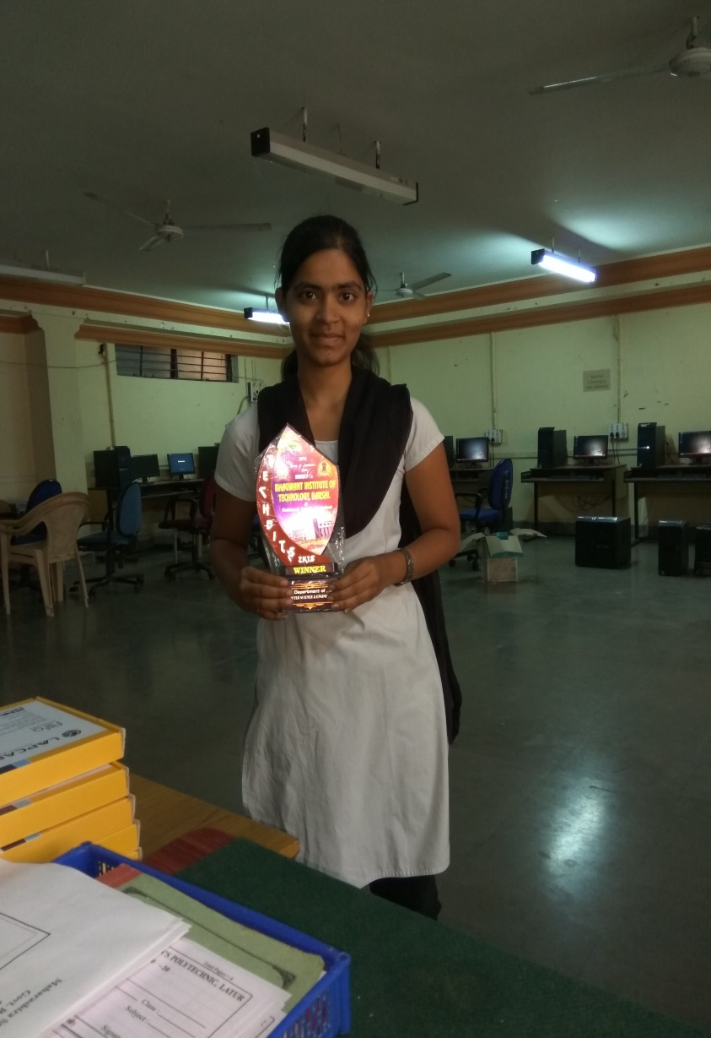
Students Achievement's(Game/ Quiz Competition)
Ms. Mayuri Jadhav Student of CO4G got prize in C Programming Code debug Competition Prize held in Barshi.

Slide 49
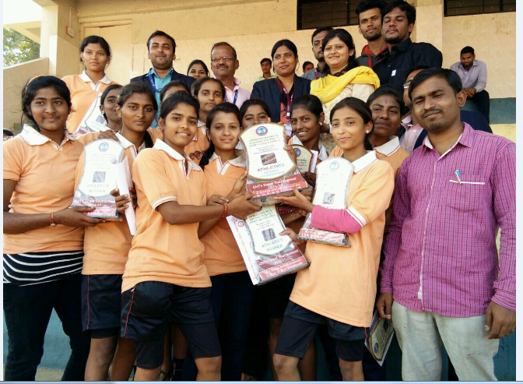

Slide 50
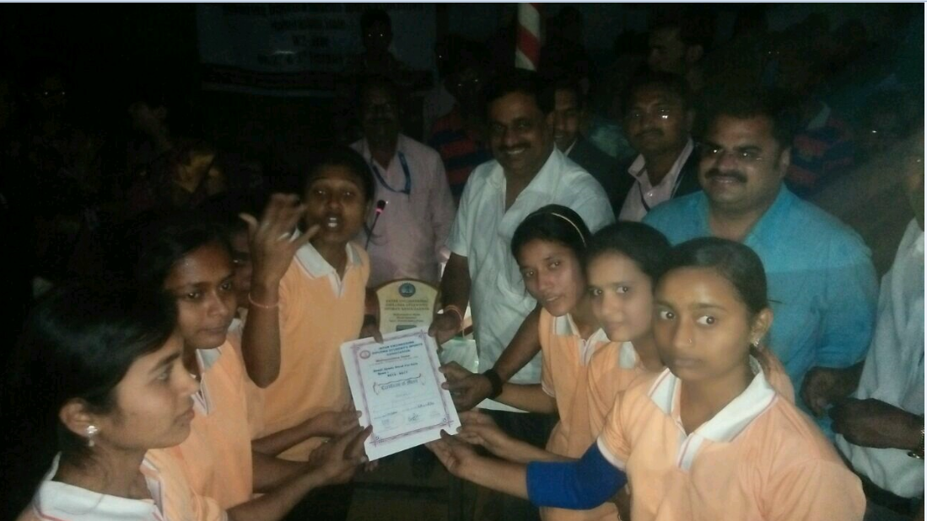

Slide 51
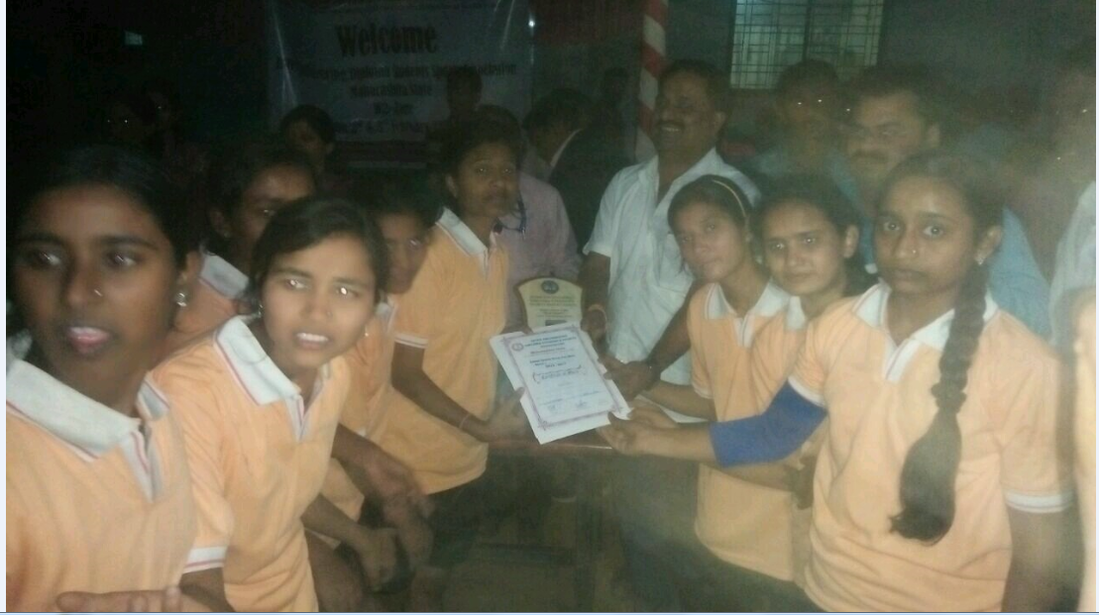

Slide 52
Thanks….

